Slide 1

Community Report System
Empowering Communities Through Digital Reporting
Presented by: [S.Raviteja]
Date: [4/15/2026]

Slide 2

What is a Community Report System?
A Community Report System is a digital platform that enables residents to report issues, concerns, and observations directly to local authorities or community organizations. Think of it as a bridge connecting citizens with the people who can solve problems—from potholes to safety concerns.
Key Concept
Connecting citizens with authorities through simple, accessible technology
These systems streamline communication, track progress, and ensure accountability. They transform how communities interact with local government, making reporting as easy as sending a text message.

Slide 3





Why Do We Need This System?
Unreported Issues
Slow Response Times
Problems like damaged infrastructure or safety hazards often go unnoticed without proper channels
Traditional reporting methods create delays between reporting and action
Lack of Transparency
Manual Processes
Citizens don't know if their reports were received or what actions were taken
Paper-based systems are inefficient, error-prone, and difficult to track

Slide 4





Our Solution: A Digital Reporting Platform
Our Community Report System is a web-based platform that makes reporting issues as simple as taking a photo. Residents can submit reports with descriptions, photos, and location tags, while administrators receive notifications and can track resolution progress.
Easy Registration
Simple account creation
Quick Reporting
Submit issues in seconds
Location Tracking
Attach exact locations
Status Updates
Track progress in real-time

Slide 5
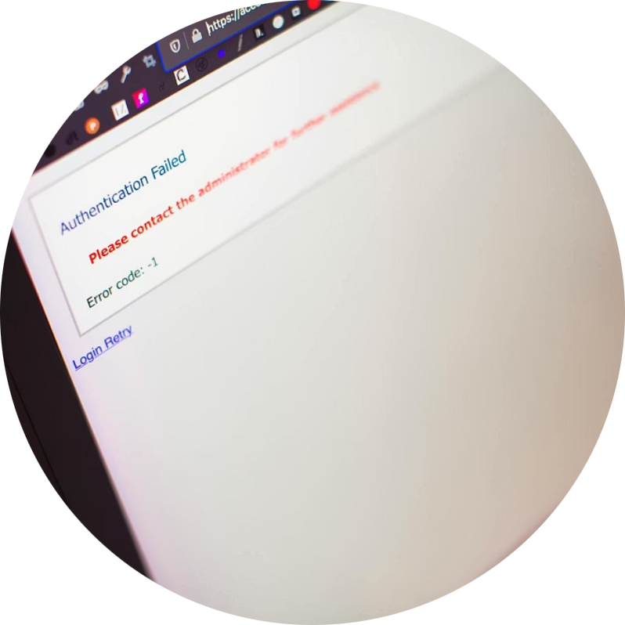

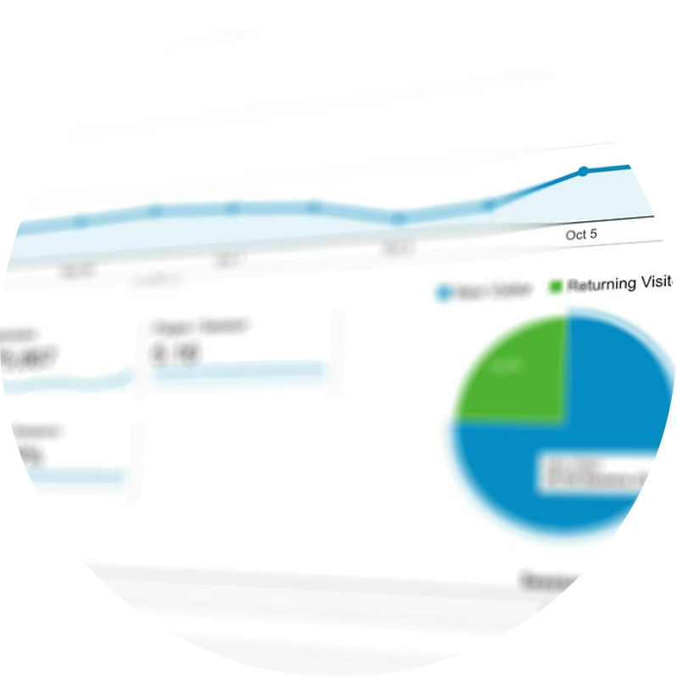

Key Features of the System
Secure User Login
Report Submission
Progress Tracking
Admin Dashboard
Encrypted authentication protects user information and ensures privacy
Easy-to-use forms with photo upload and location tagging capabilities
Real-time updates show where your report is in the resolution process
Comprehensive tools for managing reports, users, and analytics

Slide 6
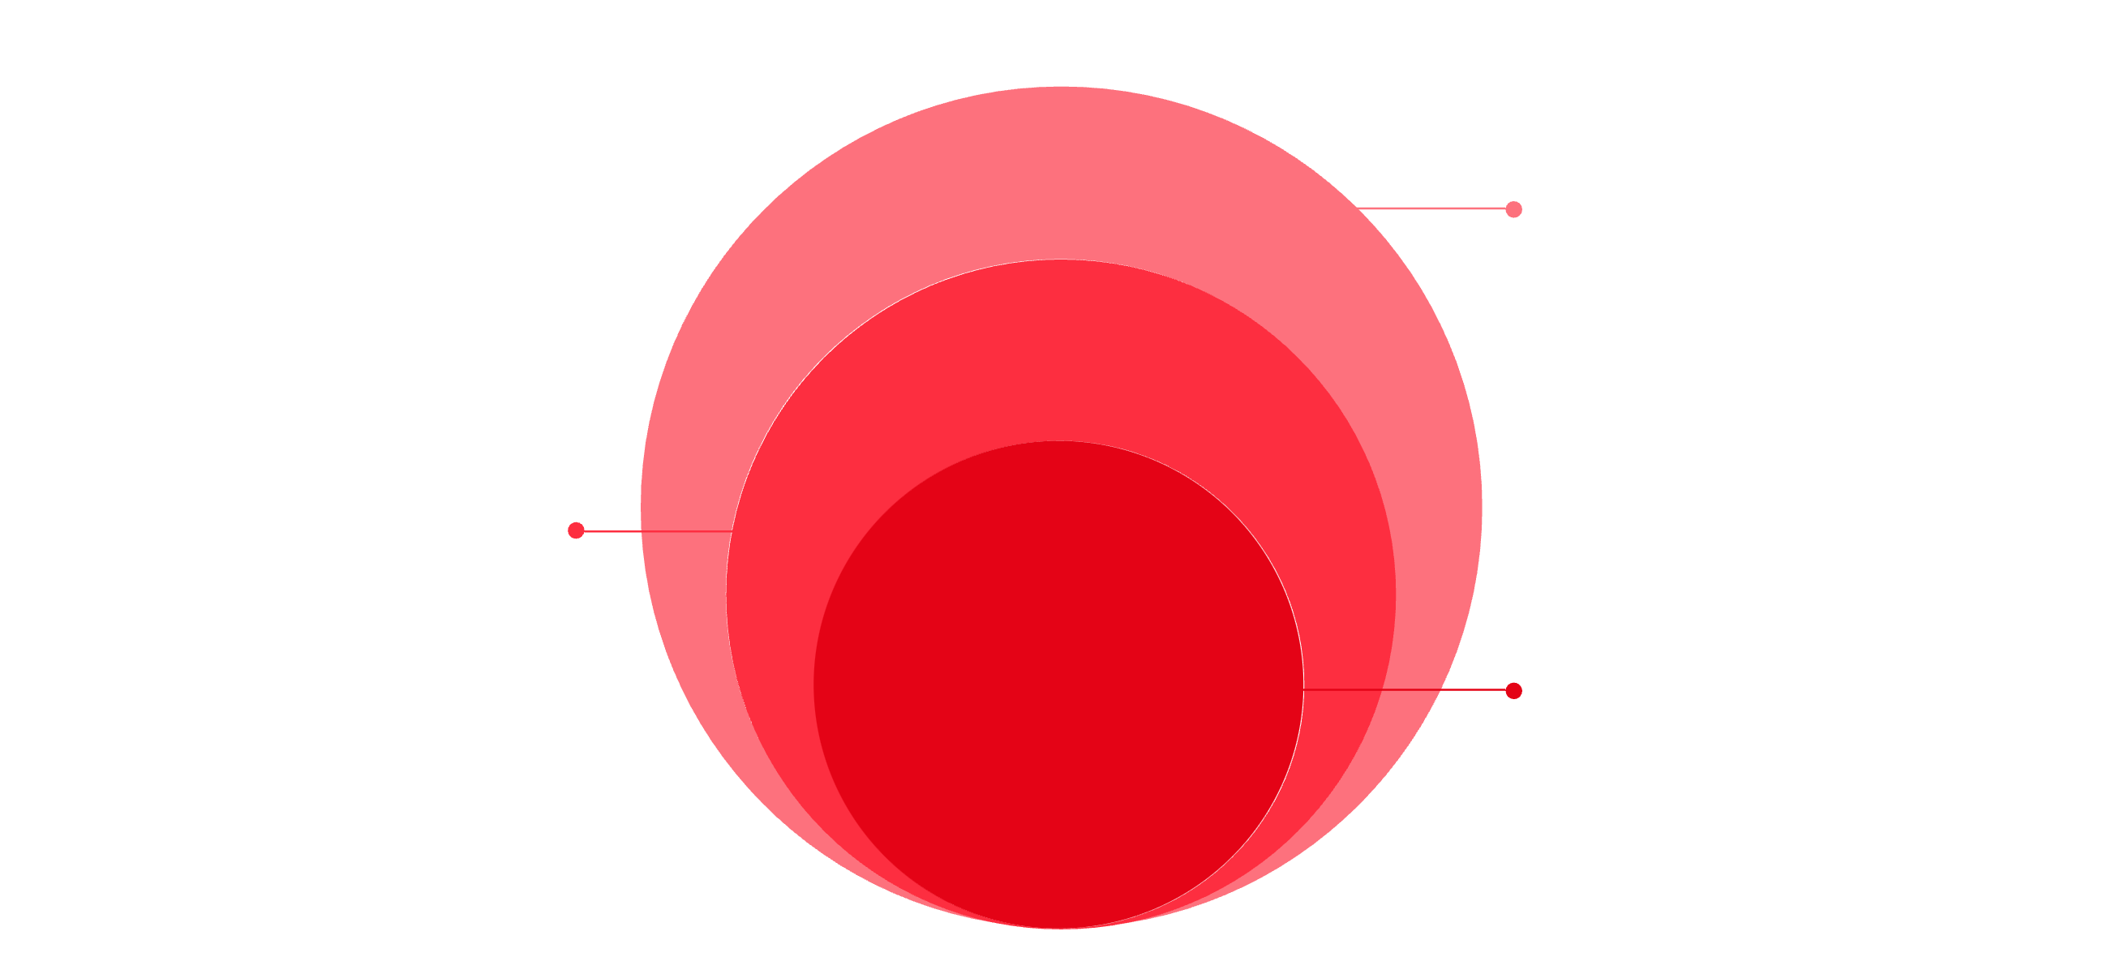
System Architecture
Our system follows a three-tier architecture that separates presentation, logic, and data layers for better maintainability and scalability.
Database Layer
Backend Layer
Structured data storage for user accounts, reports, locations, and status updates
Frontend Layer
Server-side logic handling authentication, report processing, notifications, and business rules
User interface built with modern web technologies (HTML, CSS, JavaScript) that provides responsive design across devices
Database
Persistent storage and data management
Backend
Application logic, APIs, and business rules
Frontend
User interface with HTML, CSS, JavaScript

Slide 7
System Modules
User Module
Admin Module
Account registration and profile management
Submit new reports with photos and descriptions
View and track existing reports
Receive notifications about report status
Update profile information
Manage user accounts and permissions
View all reports in a centralized dashboard
Assign reports to appropriate departments
Update report status and add notes
Generate reports and analytics

Slide 8
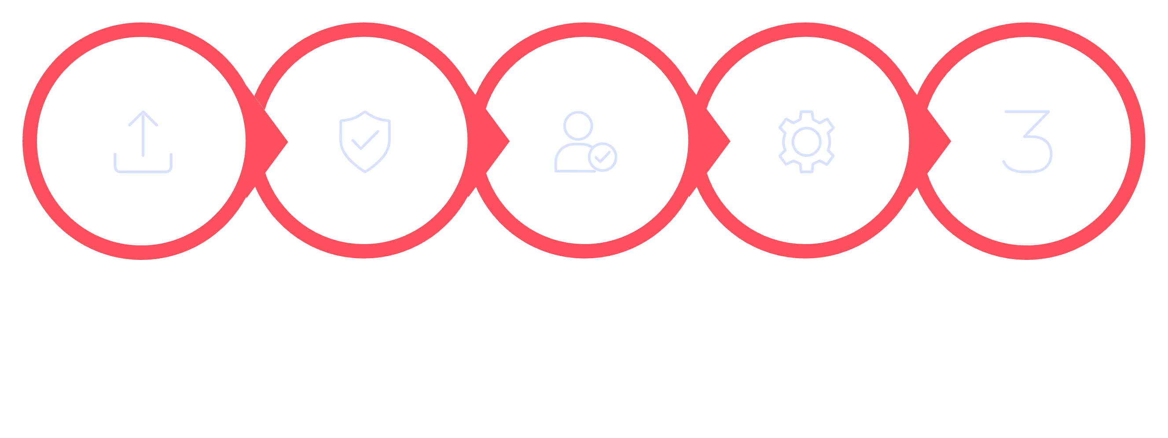
How It Works: The Complete Workflow
Submit
Validate
Review
Process
Update
01
02
Report Submission
Data Validation
Citizen submits issue with details, photos, and location
System checks information and stores in database
03
04
Admin Review
Department Action
Moderator reviews and assigns to appropriate department
Assigned team receives notification and begins resolution
05
06
Status Updates
Completion
Progress is documented and tracked in the system
Citizen receives notification that issue is resolved

Slide 9




Benefits and Real-World Applications
Efficiency
Transparency
Reduces processing time from days to hours
Everyone can see report status and progress
Accountability
Community Engagement
Tracks who is responsible for each action
Encourages civic participation and responsibility
Where This System Works
City Governments: Reporting potholes, broken streetlights, and infrastructure issues
College Campuses: Reporting maintenance issues, safety concerns, and campus problems
Housing Communities: Managing resident requests and facility maintenance
Business Parks: Coordinating facilities management across multiple tenants

Slide 10

Future Enhancements and Conclusion
What's Coming Next
AI-Powered Classification
Automatically categorize reports using machine learning
Mobile App
Native iOS and Android applications for on-the-go reporting
GPS Integration
Automatic location tagging when submitting reports
Push Notifications
Instant alerts when report status changes
Community Rating System
Rate resolution quality to improve service
Conclusion
A Community Report System transforms how citizens interact with local authorities, making reporting issues simple, transparent, and efficient. By connecting communities with the people who can solve problems, we create more responsive, accountable, and engaged neighborhoods.
Impact: Faster response times, increased transparency, and empowered communities working together to improve their neighborhoods
References
[Include your sources and references here]

